Slide 1
FUEL FOR SPORT Eating Well for Elite Gymnastics
Jennifer Sygo, M.Sc., RD
Cleveland Clinic Canada
Service Provider, CSIO and CAC

Slide 2
Overview
A Bit of Nutrition 101
Understanding Carbohydrates & Blood Sugar
Protein: For Fullness & Strength
Being Your Best
Should I Be Taking Supplements?

Slide 3
What Does My Food Do For Me?
Food & nutrition plays a huge role in gymnastics:
Your day-to-day energy
Your fuel for training & competition
Your strength, recovery, and ability to tolerate long hours of training
Your endurance: your last tumbling pass, your bars dismount, your last event of the day (or meet)
Your likelihood of getting injured, or sick
How you feel on competition day

Slide 4
To Start: Understanding Calories
We measure all of the energy we use in calories
We measure all of the energy we obtain from food in calories
Calories come from three sources:
Carbohydrates
Protein
Fats

Slide 5
To Start: Understanding Blood Sugar
Carbohydrate-containing foods ultimately break down into sugar (glucose) in our body
The good:
Sugar provides our brains with energy to think, and our muscles with energy when we train
The not-so-good:
Foods that trigger a spike in blood sugar can also cause a crash, triggering hunger, cravings, and fatigue
Blood sugars that run too high for too long can trigger the storage of excess sugars as fat in our body

Slide 6
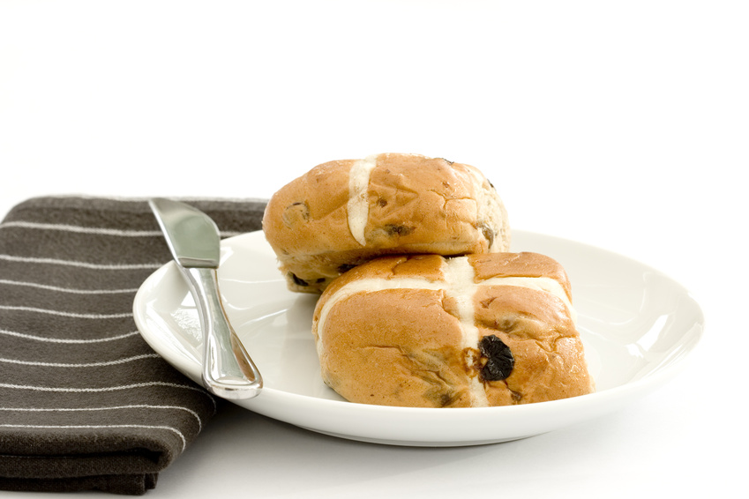
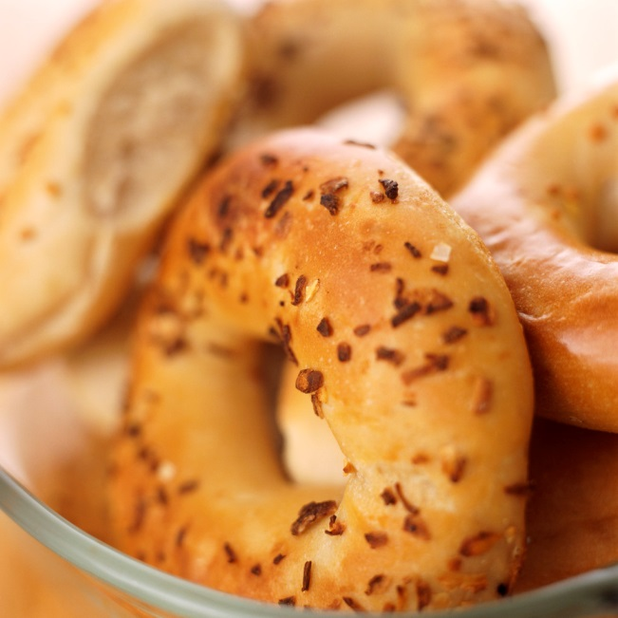
Understanding Carbohydrates
Foods that trigger this spike & crash are called “high glycemic” foods, e.g.
Foods make from corn or white rice, e.g. Corn Flakes, Rice Krispies, white rice, rice crackers
Foods made from white flour, e.g. crackers, pancakes, waffles, white bread, pitas, bagels
Boiled potatoes without the skin
Candy, pop, and other foods made from sugar

Slide 7
Understanding Carbohydrates
How can we keep blood sugar from spiking and crashing? i.e. how can we keep our energy even, and prevent hunger & cravings?
Choose carbohydrates that are made from whole, unrefined grains, beans/legumes, or whole fruits & vegetables – i.e. “lower glycemic”
Keep portions of carb foods moderate
Balance carbohydrates with protein, and/or with healthy fats
Both (and fibre) slow the breakdown of carbs into sugar

Slide 8
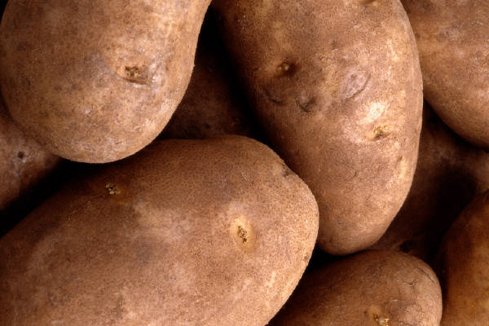
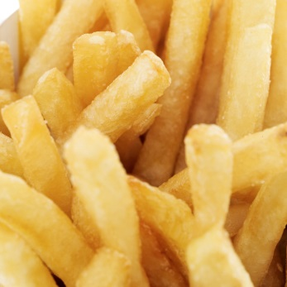
Understanding Carbohydrates
So, how much carbohydrate does a gymnast need?
Runners, swimmers, triathletes: LOTS!
Gymnasts….not so much!
Rough guideline: 1-2 servings per meal
1 serving = 1 slice of bread, ½ cup of cooked rice, pasta, quinoa, sweet potato, potato, ½ large wrap, 1/3 bagel, 4-8 crackers
VS.

Slide 9
Understanding Blood Sugar
INSTEAD OF | TRY CHOOSING
White bagel (3 slices of bread) | 2 slices whole wheat bread + turkey
2 cups of white rice with veggies & sauce | 1 cup of quinoa with chicken & veggies
3 pancakes or waffles w/ syrup & juice | 2 eggs (or whites) + 1 pancake with Greek yogurt topping
Corn Flakes, Special K, or Rice Krispies + milk | Oatmeal (not instant) with milk/soy milk + walnuts or almonds, hemp or chia seeds
Juice/Fruit drink | Water
White crackers & dip | Carrots & hummus
Smoothie made from pureed fruit | Smoothie made from fruit with milk/soy milk, Greek yogurt, or protein powder
Granola bar or cereal bar | Whole fruit + handful of nuts
Boiled white potatoes | Beans, lentils, or chick peas

Slide 10
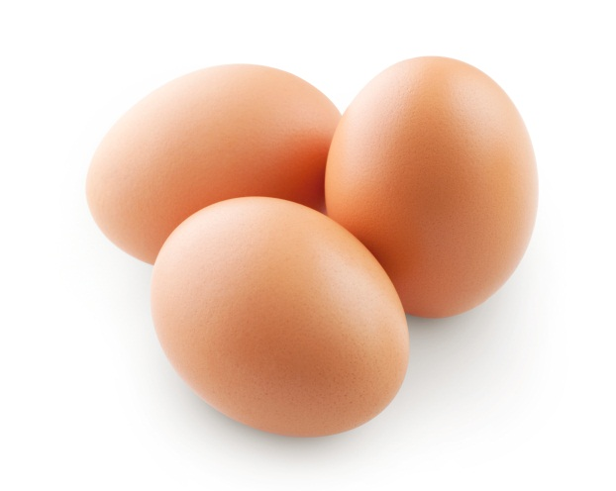
Understanding Protein
If carbs are the gas in the tank, protein’s job is to help us feel full
But just as importantly, it helps you to build and maintain muscle
Also important for recovery from workouts

Slide 11
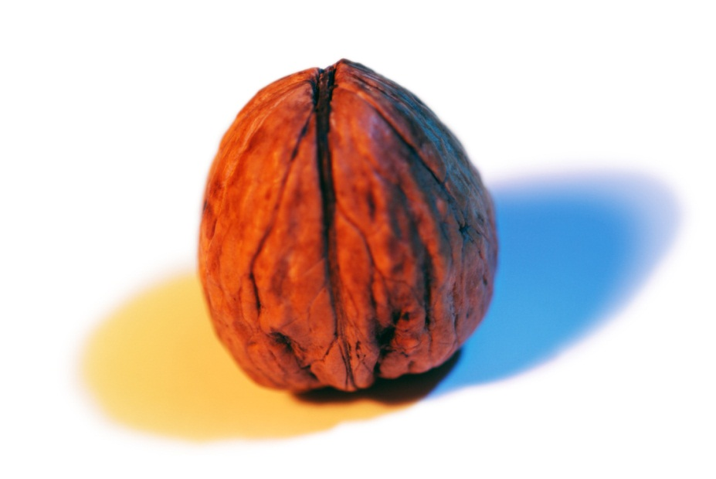
Eating for Energy
PROTEIN
Lean meats and fish (chicken, turkey, ham, roast beef; tuna, salmon)
Eggs (e.g. hard-boiled or scrambled & in a wrap)
Dairy proteins: milk, yogurt, cottage cheese, cheese
Soy protein: soya beverage, tofu, soy nuts, veggie meats
Beans & legumes: chick peas, lentils, black beans, hummus
Nuts & seeds: almonds, walnuts, sunflower seeds, pumpkin seeds, peanut or almond butter
Other: PowerBar/protein/meal replacement bars; whey protein powder; Breakfast-to-Go
CARBOHYDRATES
Whole grain cereals (oatmeal, higher fibre cereals, etc.)
Whole grain bread products (wrap, bread, pita, bagel)
Grain products (brown or wild rice, whole wheat pasta, quinoa, etc.)
Starchy vegetables (potato, sweet potato, squash, corn, turnip, etc.)
Fruit (preferably fresh or frozen instead of canned or juice)
Non-starchy vegetables (any kind)
NB: there are carbohydrates in milk, yogurt, beans and legumes
Other: Granola bars, baked goods, graham crackers, fig newtons, etc.)

Slide 12
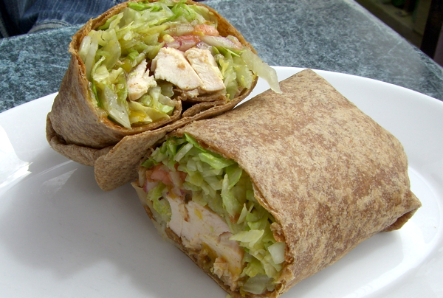
Meal Timing & Balanced Snacking
For optimal energy, try to:
Avoid going longer than 4 hours without eating
Combine a source of protein (for fullness) and carbohydrates (for energy) at each meal and snack

Slide 13
Balanced Snack Ideas
Yogurt, berries, and granola
Smoothie with fruit, milk, and yogurt
Hummus and carrot sticks
Hard-boiled egg and whole grain crackers
Cottage cheese and pineapple
Whole wheat English muffin with cheese
Peanut or almond butter and apple or banana
Almonds, walnuts, or cashews, raisins, and Cheerios
Mini can of flavoured tuna and whole wheat pita
Whole grain cereal or oatmeal with milk
Leftover chicken in a whole wheat wrap

Slide 14
Being Your Best
Foods that give energy & tons of nutrients:
Fruits, vegetables, lean meats, yogurt, root veggies, whole grains, nuts, seeds, eggs
Eat whole fruit and vegetables instead of juices (even 100%), purees, fruit/veg “bars”
Aim to eat 5 colours of fruits & vegetables per day
Foods that can take energy away:
Sugary foods, pop, white noodles & rice, white bread & bagels, sugary cereals & granola bars

Slide 15
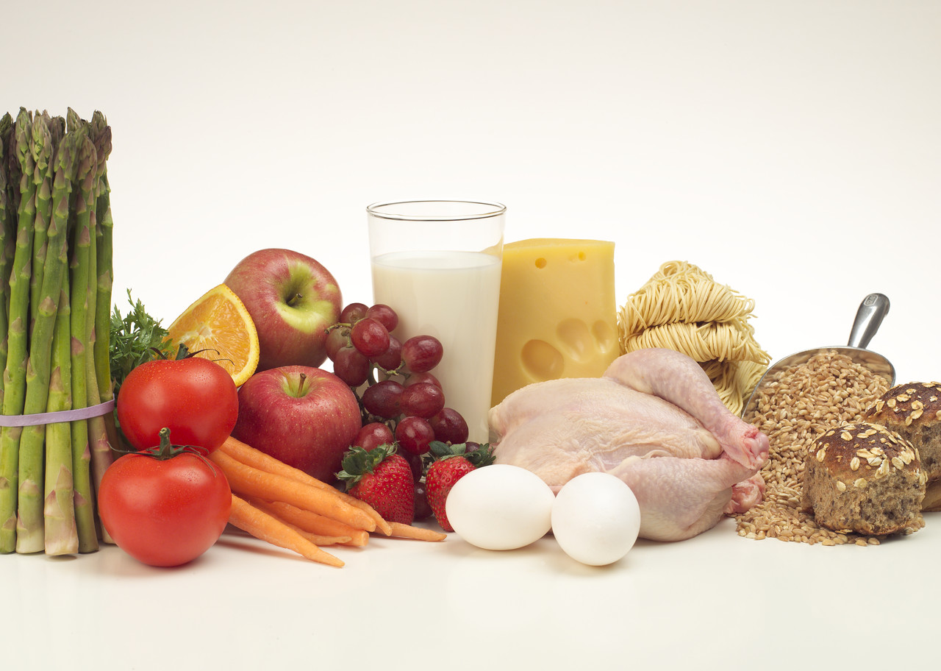
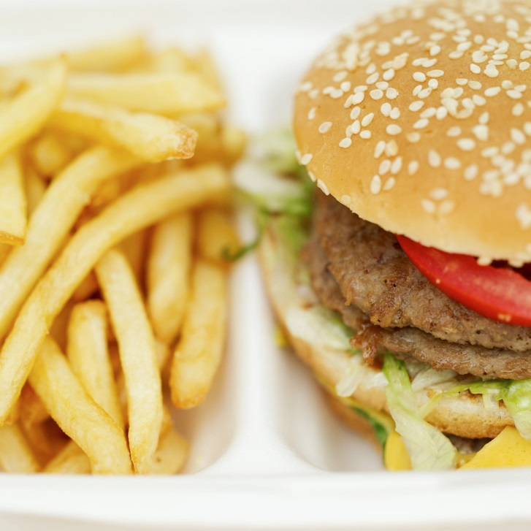
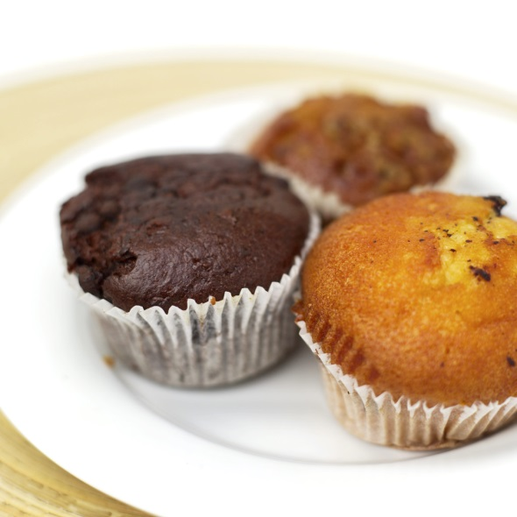
VS.

Slide 16
Being Your Best
Basic guidelines:
Include protein at each meal and snack
Have a handful of nuts or seeds each day
Try to eat fish (especially salmon, trout & other oily fish) twice/week
Limit added sugar to less than 20 g (4 tsp)/day
Hydrate so that you “pee clear” and choose plain water whenever possible

Slide 17
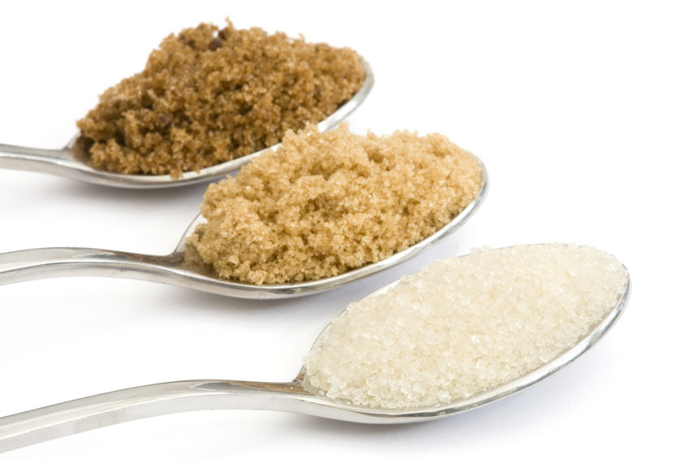
Being Your Best
To be healthy, we should try to eat less than 5 teaspoons (or 20 grams) of added sugar per day. Which of the following foods contains the most sugar?
1 teaspoon = 4 grams of sugar

Slide 18
Options
10 oz. (regular) Iced Cap from Tim Horton’s
Can of cola
Small DQ Blizzard
Small McDonald’s milkshake

Slide 19
Answer
Tim Horton’s Iced Cap: 32 grams = 8 tsp
Can of cola: 42 grams = 10.5 tsp
Small DQ Blizzard: 61 grams = 15 ¼ tsp
Small McDonald’s milkshake: 77 grams = 19 ¾ tsp

Slide 20
Tips for Cutting Down on Sugar
If you’re going out for ice cream, stick to a small or junior-sized cone, rather than a shake or ice cream treat
Drink plain water more often
Mix fruit-flavoured (sweetened) yogurts with plain yogurt to cut the added sugar in half
Mix chocolate milk with plain white milk
Look for cereals and granola bars with less than 8 g (2 tsp.) of sugar
Buy plain oatmeal or low sugar cereals and add your own sugar if you need to (you’ll probably add less than the people who make it)

Slide 21
Being Your Best
Foods for key nutrients:
Kale, spinach, Swiss chard, collard greens: for bones, skin
Beets, spinach, celery: for circulation, endurance
Hemp seeds/hearts, chia seeds: for magnesium (muscle & bone health)
Potatoes, sweet potatoes, avocadoes: for potassium (electrolyte, healthy circulation)
Almonds: skin health, healthy circulation

Slide 22
Being Your Best
Before you hit the gym in the morning, plan a small to medium-sized balanced meal/snack
i.e. includes a protein & carbohydrate
Why? For fuel to use during workout, without a spike & crash
Examples:
Cereal (less than 8 g sugar/30 g svg) + milk
Oatmeal (pref. plain/slower-cooked) + milk
Whole wheat toast/English muffin + cheese or PB
Chicken or turkey sandwich/wrap
Smoothie w/ milk/yogurt & fruit

Slide 23
Being Your Best
During gym, if it is going to be more than 4 hrs since your last meal, plan a small snack to help energize you for the second half of your workout:
Fruit or fruit juice (ok in this case)
Yogurt
Few bites of sandwich/wrap
Clif bar/Builder’s Bar/Power Bar – about 1/2

Slide 24
Being Your Best
After your workout:
Recover with ~10-20 grams of protein + some carbohydrate within 15-30 minutes
Then have your regular meal (lunch or dinner)
E.g. ½-3/4 cup Greek yogurt (fruit-flavoured)
Banana + 1 cup of milk or soy beverage
Smoothie with milk/soy beverage, yogurt, berries, banana – add some spinach?
PB/almond butter/cheese & whole grain crackers
½ scoop whey protein powder + banana

Slide 25
Being Your Best
For travel:
Take responsibility for your nutrition!
Pack familiar foods:
Oatmeal
Nuts, seeds (almonds, walnuts, cashews, pistachios, pumpkin seeds, sunflower seeds) +/- dried fruit (raisins, apricots)
Lower sugar granola bars (e.g. Nature Valley, Kashi)
Meal replacement/protein bars (SimplyBar, Clif, PowerBar, Builder’s Bar, etc.)

Slide 26
Do I Need a Supplement?
Everyone is different
Avoid supplementing without a specific purpose
Having said that, is there is one supplement to take, it should be vitamin D
Possibly prevent stress fractures, immune system, reduce pain
Research suggests gymnasts are particularly prone to vitamin D deficiency

Slide 27
Do I Need a Supplement?
Where do we get vitamin D?
The sun
Where don’t we get it from?
Food (not much, anyway)
When do we need it most?
Definitely winter (Oct-March), but unless exposed to sun in mid-day without sunscreen for 10-15 minutes most days in summer, then should take it year-round

Slide 28
Do I Need to Supplement?
How much?
At least 1000 IU/day
Most: 2000-3000 IU/day = 2-3 min summer sun
Up to 4000 IU/day is safe
As drops, tablets, chews
Ideally with food (50% better absorption)
Can take several days’ worth at once

Slide 29
Do I Need to Supplement?
Otherwise, common supplements to consider:
Omega-3 fish oil supplement – if not getting enough fish; natural anti-inflammatory
Magnesium – for restless, achy legs/muscles, headaches, or constipation
Calcium – for bones
Multivitamin – if picky eater, allergies, missing food groups

Slide 30
THANK YOU!
www.jennifersygo.com
www.clevelandclinic.ca
jsygo@rogers.com
Twitter: @JenniferSygo

